Slide 1
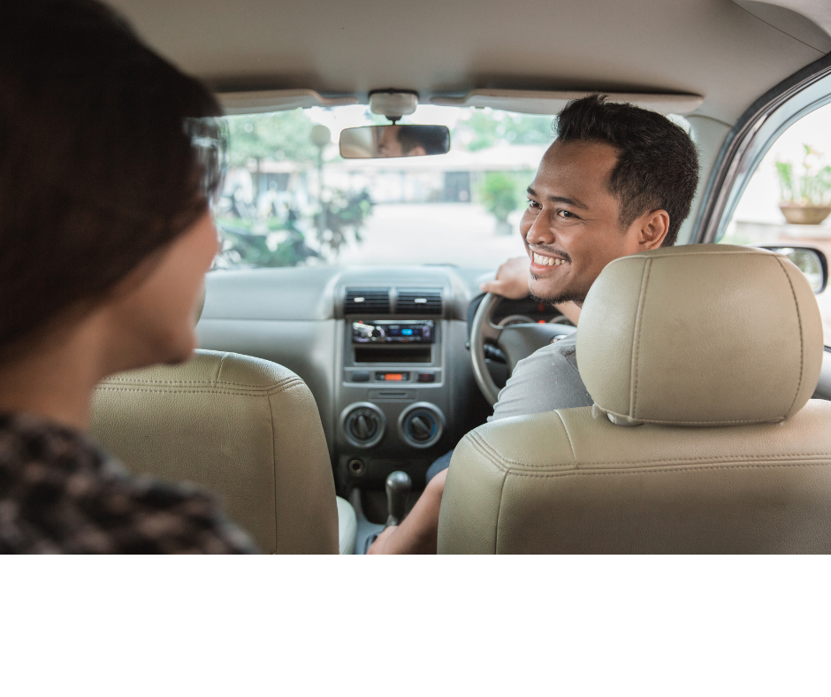
Customer Experience Program
Produced for the Tasmanian Taxi Industry
1

Slide 2
Welcome and Introductions
TRAINER Introductions
Participant Introductions
2

Slide 3
Housekeeping
Emergency assembly point
Breaks
Mobile Phones
Ask questions, build, challenge
Good practice
3

Slide 4
Course Overview
Knowledge & Learning
The Tasmanian Visitor Experience
Delivering a Great Customer Experience
Professional Standards & Personal Attributes
Customer Feedback
4

Slide 5

Important Services
Taxi’s meet a variety of transport needs including:
Basic mobility for less mobile community groups, such as the elderly and people with disabilities.
They can be used for transport in emergencies
For general transportation for non-drivers
An alternative transport option for vehicle owners and/or public transport users
Mobility for tourists and visitors
5

Slide 6
1. The Tasmanian Visitor Experience
6

Slide 7
The Tasmanian Visitor Experience
Delivering an exceptional Customer Experience to customers:
Local
Interstate
International
7

Slide 8

8

Slide 9
The Tasmanian Visitor Experience
What is unique and special about Tasmania in your eyes?
Why do people travel here from all over the world?
What do they want to see?
How do they want to feel?
Your opportunity to give people an amazing Tasmanian Visitor Experience
9

Slide 10
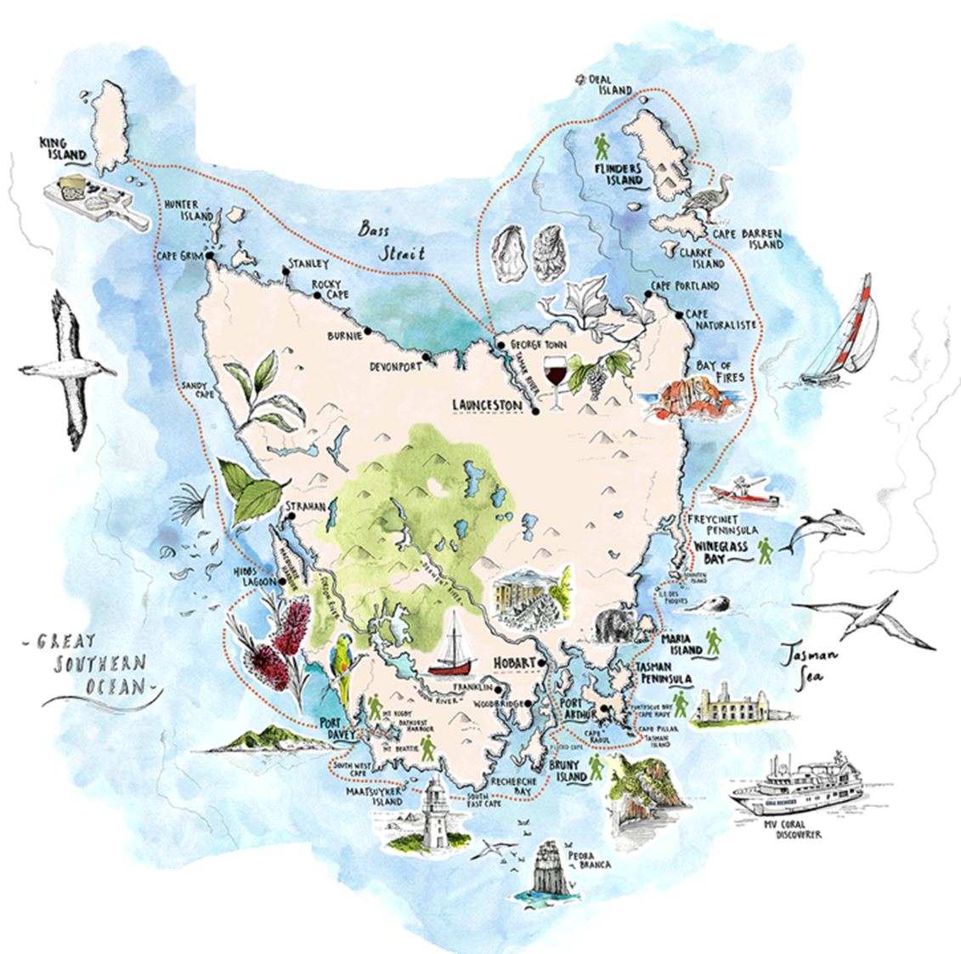
We are all Connected
To the customer, we are all a part of their Tasmanian Visitor Experience
Business / Service
Community
Township
Region
Tasmania
How does your service impact on the Tasmania Brand?
Why does it matter what you do locally?
10

Slide 11
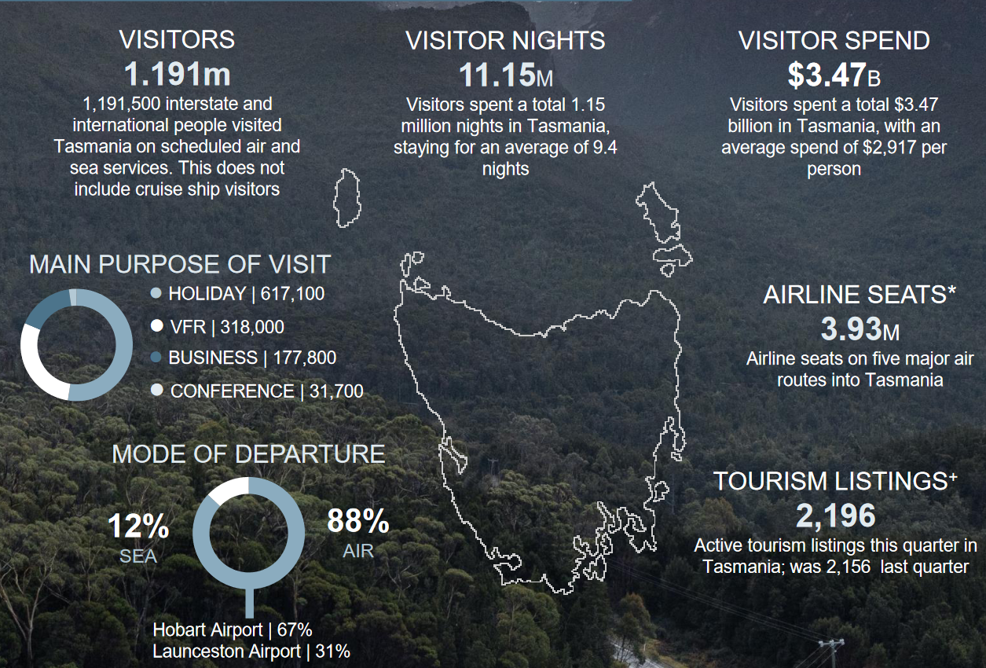
Visitors to Tasmania: 1,191,500
(up 74.6%)
Nights spent in Tasmania: 11,145,900
(up 52.1%)
Expenditure by visitors: $3.476 billion
(up 87.3%)
Tasmanian Visitor Survey data, year to December 2022
Tourism Tasmania
11

Slide 12
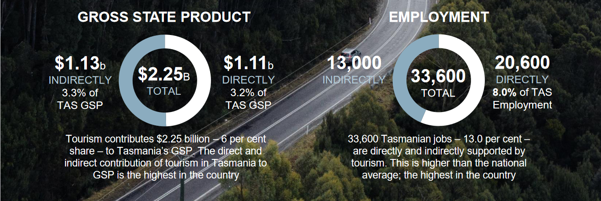
12
Notes:
BITRE Bureau of Industry, Transport and Regional Economics 2021-22
+ATDW Australian Tourism Data Warehouse, current as at 2 December 2022.
Tourism Tasmania actively encourages tourism businesses to register with ATDW; changes in number
reflect ATDW registrations and do not necessarily mean businesses are new or have closed.
Find more data and insights on Tasmania’s visitor economy at
www.tourismtasmania.com.au/research/visitors

Slide 13
2. The Customer Experience
13

Slide 14
YOUR WORST-EVER CUSTOMER SERVICE EXPERIENCE?
14
Notes:
WHAT MADE IT THE WORST?
WHITBOARD - WORSTS WORDS ON LEFT COLUMN
And who else did you tell?

Slide 15
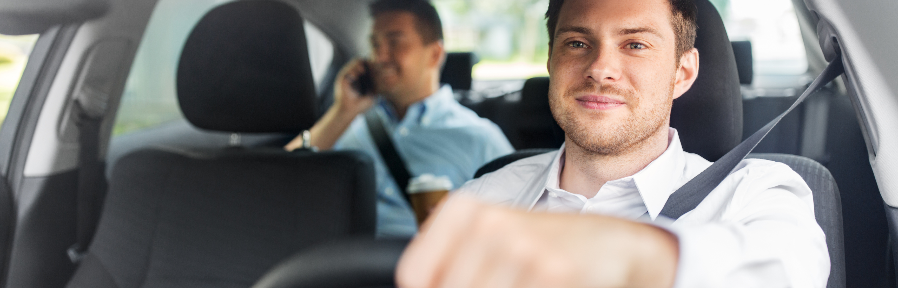
YOUR BEST EVER CUSTOMER SERVICE EXPERIENCE?
15
Notes:
WHAT MADE IT THE BEST?
WHITEBOARD – BESTS WORDS ON RIGHT COLUMN

Slide 16
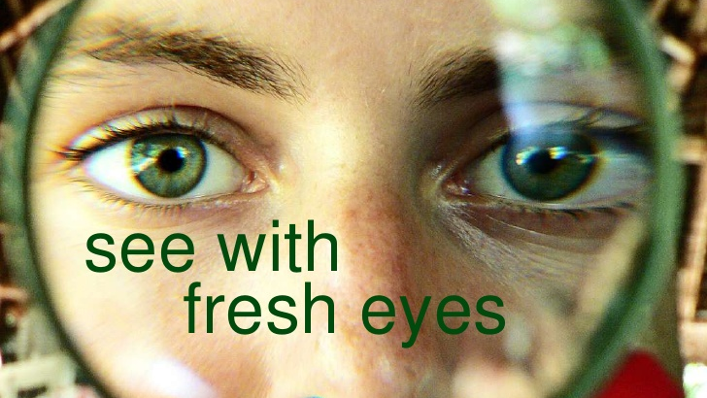
Looking Through your Customer’s Eyes
16
Notes:
Customer Service is the combination of feelings, thoughts and emotions throughout the journey with your brand
A customer may not remember what you said but will always remember how you made them feel.
Each customer journey is unique affected by perceptions, emotions, events, and decisive moment that shape the experience
A decisive moment is your opportunity to impact a customer’s choices; this is when they will become an ambassador, advocate or detractor
Get closer to your customers through the journey to continually own their decisive moments
The part of the brain that controls decision-making also controls feelings, loyalty does not come from logic – comes form emotion

Slide 17
Customer Service is the combination of feelings, thoughts and emotions throughout the journey with your brand
A customer may not always remember what you said but they will always remember how you made them feel.
Each customer journey is unique and affected by perceptions, emotions, events, and decisive moments that shape the experience
A decisive moment is your opportunity to impact a customer’s choices; this is when they will become an advocate or detractor
The part of the brain that controls decision-making also controls feelings, loyalty does not come from logic – it comes from emotion
17

Slide 18

What do Customers Want?
The Top 5 most important things to customers:
  Customer Service
  Reliability, keeping promises
  Quality
  Ease of doing business
  Value for money
18
Notes:
Consumers are willing to spend more with companies that provide outstanding service, and they will also tell, on average, twice as many people about bad service than they are about good service.
Ultimately, great service can drive sales and customer loyalty.
How do you provide the following things to customers?
According to market research into what great customer service means to a customer the top 5 most important things are:
Value for money, price, competitiveness
Customer Service
Reliability, keeping promises
Quality
Ease of doing business

Slide 19
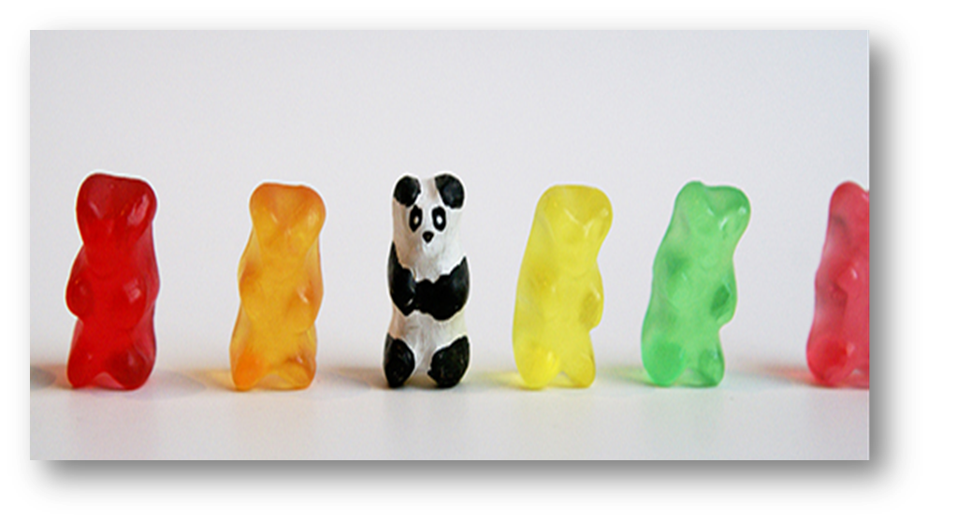
What is your point of difference?
19
Notes:
YOUR only REAL point of difference,
IS YOU and YOUR SERVICE!

Slide 20
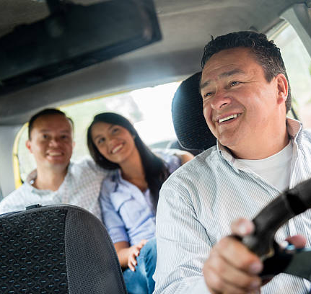
What creates a Great Customer Experience?
Personal Presentation
Vehicle Presentation
Professionalism
Hospitality
Knowledge
20
Notes:
To the customer – you are the business, you are a representative of the whole Tasmanian Taxi Service Sector and reputation.
Customer service is not an option it is vital for a positive customer experience.
Providing a great customer experience through your service ensures your job, the business you work for, and the Tasmanian Taxi Service sector are viable now and into the future.

Slide 21
3. Professional Standards
21

Slide 22
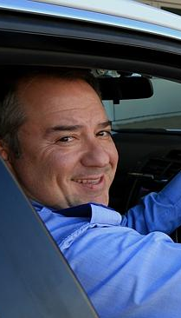
Personal Presentation
Professional Standards
Personal Hygiene
Clothing
Vehicle Presentation
22
Notes:
Positive Attitude
Attentive – listen and care (make them know they matter)
Give accurate information, don’t be afraid to say “I don’t know, but I will find out”
Friendly approach – watch for non-verbal and body language signs
Eye contact (best response in 2 seconds)
Learning to say no with tact and courtesy and confidence
Stay positive
Attention to detail
Go the extra mile
Use names whenever possible
Work Ethics
Punctuality
Time Management
Manage multi-tasking
Follow the chain of command
Etiquette
Telephone
Greeting
Holds
Transfers
Workspace
Clean from clutter
Organized (know where to find things and put them back in their place)
No food, drinks in covered containers
Socialising limited to break times - fun is good – socialising with other staff during shifts is not
Appearance

Slide 23
Professional Standards
Honesty
When dealing with money and property and in the way you interact with customers
Dedication
Being on time and able to work hard even if you are having a bad day
Attitude
Being courteous, polite and helpful. Trying to do your best at all times. Having a ‘can-do’ approach
Integrity
Doing things the right way, behaving ethically. Not looking for short cuts or trying to ‘get away with things’ when you think nobody will know
Repetition
Being prepared to do the same thing over and over again. Remember you may have done the same thing many times, that day to your customer this is their only experience with you.
Ethical
Avoid any form of sexual harassment, physical or mental abuse or intimidation
23

Slide 24
Professional Standards
It is important that you know how to correctly use the Eftpos machine, Taxi Meter, communication channels with radio dispatch and security camera systems and associated functions
Appearance
Taking pride in the way you look. Maintain good personal hygiene and keep your clothing clean and crisp.
If you look good you feel good and so do your customers.
Teamwork
Respect diversity in other drivers and other taxi operators and learn to communicate with your workmates, and help them out when you can. They will do the same for you. You can only do your job if everyone else is doing their job and vice versa.
Communication
Being a good listener as well as ensuring what you say is really what you mean.
Speak clearly, at a reasonable pace and use positive body language
Knowledge
24

Slide 25

Standards
25
Notes:
Taxi Service Code of Conduct provides Guidelines and sets expectations for drivers
Handout Code of Conduct
Before the hire
The law says you must
Have a current driver licence and ancillary certificate to drive a taxi.
Meet the National Commercial Medical Assessment Fitness to Drive Standards to drive a public vehicle.
Be a suitable person (of good character) to drive a taxi.
Be able to safely and competently drive a taxi.
Know how to operate the taximeter installed in the taxi.
Display your identification card in the taxi.
Know and apply the road rules when driving.
Be alert when driving - be free of drugs, alcohol and fatigue.
Park a taxi in a taxi zone, in the first vacant space and remain seated in the taxi.
Allow another taxi to leave the taxi zone.
Before driving a Wheelchair Accessible Taxi, you must have successfully completed the course of instruction relating to people with disability.
The Accreditation Standards say you must
Undertake a pre-departure inspection of the taxi before starting your shift.
Notify the appropriate person if a defect or vehicle fault is identified during the pre-departure inspection.
Make and update pre-departure, fault and incident records as required.
Practice operating and using to fully understand the taxi’s operational characteristics before taking any passengers in the taxi.
Undertake and participate in training and coaching provided by the taxi service.
The Code of Conduct says you must
Know how to use the:
EFTPOS machine
taximeter
communication channels with the radio dispatch service or radio room
top light
security camera system, and
panic alarm.
Understand the function of the tariff lights
Respect diversity in other drivers and other operators.
Check the taxi is clean and tidy.
Look professional, neat and well-groomed.
Have knowledge of the area you are driving or can use navigational tools (like Google Maps) during a hire.
Keep up to date about changes to the industry, road networks, road closures and events.
Keep up to date about changes to the road rules and road safety best practice principles.
Keep up to date with the taxi service’s policy and procedures in relation to safety.
Not smoke in or around taxis.
Only park in a taxi zone when there is an available space.
During the hire
The law says you must
Accept passengers, regardless of a passenger’s race, gender, religion, age or distance to be travelled - provided that the hire is wholly within, or begins or finishes, in the taxi area specified on the taxi licence on the taxi.
You can refuse a hire if you believe that your personal safety is at risk.
If driving a wheelchair accessible taxi -accept passengers that are not wheelchair reliant.
Accept passengers travelling with transport assistance animals.
Give reasonable assistance to help passengers enter the taxi.
Ensure that a wheelchair carried in a wheelchair accessible taxi (WAT) is restrained in the wheelchair restraint assembly installed in the taxi in accordance with AS/NZS 1054.1:2015.
Only allow a further hirer to be in the taxi with the consent of the other hirer(s).
Start the hire by turning on the taximeter for the correct tariff.
Use the correct tariff for the hire.
Take the quickest, shortest and most appropriate route for the hire.
Charge the correct fare and give passengers who pay cash the correct change.
Stop the taximeter for any time that the taxi is delayed because of:
a lack of fuel in the taxi
a mechanical breakdown of the taxi
a traffic accident involving the taxi
the lawful closure of a bridge
the directions of a police officer
an event that you could have prevented or avoided, or
when reaching the destination or in the case of multi-hires, on the arrival of the last destination.
The Code of Conduct says you must
Acknowledge all passengers to your taxi by polite greeting.
Dress, speak and act professionally with all passengers.
Use clear and concise language and show courtesy in your communication.
Listen to, be sensitive to passengers with special needs such as helping with seatbelts, closing doors etc.
Recognise cultural and gender diversity and make allowances for individual differences:
use acceptable, ethical and respectful behaviour towards passengers and other road uses
avoid any form of sexual harassment, physical or mental abuse or intimidation towards passengers and road users.
Be able to safely place child restraints in the taxi.
Advise passengers to wear seatbelts.
Help passengers load and secure their luggage.
Comply with reasonable requests of passengers by turning off the radio, heater or fan.
Drive the taxi in a safe, smooth and controlled manner and in a way to reduce wear and tear on the taxi.
Stop the taxi in a place that passengers can disembark safely.
End of hire
The law says you must
Ask for payment which is equal to or less than the sum of the total fare and charges shown on the taximeter.
When passengers exit the taxi, you must reset the taximeter.
The Accreditation Standards say you must
Identify and record any vehicle defects detected during the hire.
Identify, respond and record any incidents that occurred during the hire.
Notify any safety risks identified during the hire.
The Code of Conduct says you must
Give reasonable assistance to help passengers exit the taxi.
Help passengers by unloading luggage and returning belongings such as taxi smartcard, credit or savings card.
Remind passengers not to leave belongings in the taxi.
Check the taxi for lost property.
Assist with the return of lost property left in the taxi by handing it to the nearest police station or booking service provider.
Comply with passenger complaint and feedback mechanisms.
You can refuse a hire if you believe that your personal safety is at risk

Slide 26
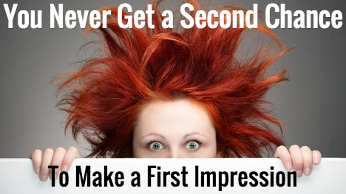
Customers will not always remember what you said but they will
always remember how you made them feel.
26
Notes:
They say that you only make one first impression, and these impressions can be more powerful than we realise. Although we are taught never to judge a book by its cover, when we meet someone for the first time our brains react to a large amount of verbal and non-verbal communication, which often gives us a fairly accurate impression of the person we are talking to.
Research has shown that we can make an accurate judgement of someone in just a few seconds, and that these first impressions can be as accurate as the impression you get of someone over a long period of time. What’s more, first impressions are incredibly hard to change, so it is very important to make a good first impression.

Slide 27
The 7-11 Second Quiz
1- Cleanliness
2- Warmth (engaging)
3- Credible
4- Knowledgeable
5- Responsive
6- Friendly
7- Helpful
8- Understanding
9- Courteous
10- Confident
11- Professional
27
Notes:
Researchers say it takes 7-11 seconds to make a good first impression
People make up their minds in 7-11 seconds whether they like you or not!
People buy YOU
7-11second quiz
On a SCALE OF 1 TO 10 how would you RATE YOURSELF?
Everyday – It is important to think about how consistent you are when delivering service.
Is it the same - TODAY?, YESTERDAY?, TOMORROW?
To deliver a great customer experience every time you need to first
Be aware of the areas then have a way to measure where you are at any time and have ways for how to adjust or reset to being present and engaged with each customer.

Slide 28
4. Effective Communication Skills
28

Slide 29
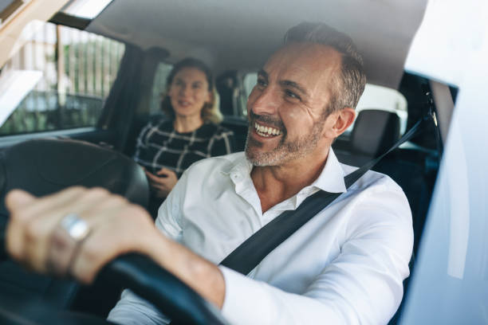
Effective Communication Skills
Communicating at work
Delighting your customers
Active Listening
Positive Attitude
Approachable
WORKS WELL UNDER PRESSURE
PATIENCE/RESPECT
ATTENTION TO DETAIL
KNOWLEDGE
29

Slide 30
Passengers with Disabilities
Communication
- Be patient and respectful while interacting with customers
- Use clear language and speak directly to the passenger
- Consider all forms of communication styles
Physical Accessibility
- Ensure you can use the vehicles accessibility features such as ramps, mobility aids or lifts for passengers using wheelchairs
- Assist passengers with boarding and disembarking, offering support as needed
- Be mindful of leaving sufficient space for passengers with mobility aids and avoid blocking wheelchair ramps and designated areas
- Assist by helping with seatbelts and closing doors
Sensitivity & Empathy
- Treat passengers with disabilities as individuals with dignity and respect, acknowledging their ability rather than focusing on limitations
- Be aware of the emotional and physical challenges they may face, and display empathy and understanding
- Avoid making assumptions about a person’s abilities or needs based on their disability
Assistance & Support
- Offer assistance, but always ask before providing help. Respect the passenger’s autonomy and independence
- Be prepared to help secure mobility aids or adjust seatbelts if requested
- Familiarise yourself with local accessibility resources, such as accessible venues or organisations that provide support to people with disabilities
- Accommodate and welcome assistant animals
30

Slide 31
5. Knowledge & Learning
31

Slide 32

Knowledge
What do you need to know?
What do your customers want to know?
Local area knowledge
Recommendations
There is always more to learn about your area and Tasmania
32
Notes:
Knowledge is an acquaintance with or understanding of facts and truths
Learning is a willingness to become acquainted with facts and truths not yet understood
Working Knowledge
Job description, responsibilities and performance expectations
Where to find policies and procedures
Department policies, procedures and expectations
Stay current on email and department updates for up-to-date information
General Knowledge
Cross training or knowledge of other department functions
Willingness for continued learning

Slide 33

Knowledge and Awareness
Route Knowledge
A well-informed taxi driver possesses comprehensive knowledge of the local area, including the most efficient routes to various destinations, allowing them to navigate the area effectively and avoid traffic congestion. The ability to choose the optimal route demonstrates expertise and enhances the passenger's experience by minimising travel time and reducing frustration.
Traffic Awareness
Staying updated on current traffic conditions and road closures enables taxi drivers to make informed decisions about route adjustments. By leveraging real-time traffic data or using navigational tools such as GPS or Sat Nav during the hire, drivers can proactively avoid congested areas.
Safety and Security
Understanding traffic rules and regulations, driving the taxi in a safe, smooth and controlled manner, following speed limits, and maintaining a safe driving approach enhance passenger safety and instil confidence. Well-trained drivers prioritising passenger security contribute to a positive customer experience by creating a sense of trust and reliability. Interacting appropriately with other road users both verbally and through driver’s behaviour also creates safe driving practices.
33
Notes:
Knowledge is an acquaintance with or understanding of facts and truths
Learning is a willingness to become acquainted with facts and truths not yet understood
Working Knowledge
Job description, responsibilities and performance expectations
Where to find policies and procedures
Department policies, procedures and expectations
Stay current on email and department updates for up-to-date information
General Knowledge
Cross training or knowledge of other department functions
Willingness for continued learning

Slide 34
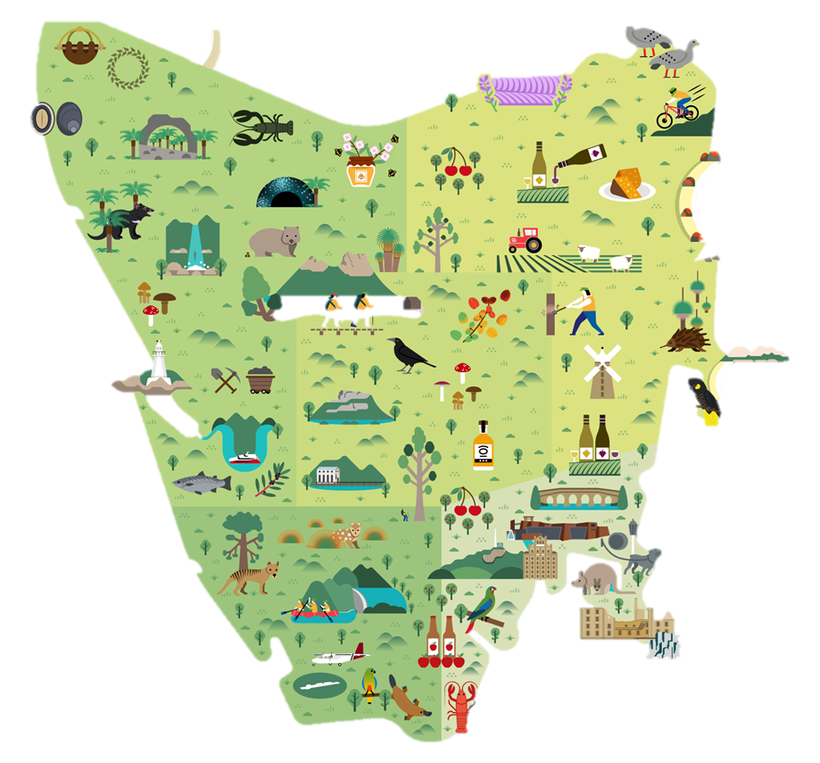
Things To Do…
Local Shopping
Medical services
Food & Wine
Family Friendly
Hire & Transport
Adventure
History
Local Tours
Museums & Galleries
Wilderness Areas
Wildlife& Nature
34

Slide 35
6. Handling Complaints
35

Slide 36

Complaints are Gifts
Thank the customer for their complaint
Complaints are opportunities to learn and improve
1 in 25 will tell you the other 24 will tell everyone else!
36

Slide 37

Apologising……
Does not always mean that you’re wrong and the other person is right
It means that you value the customer experience more than your ego
37

Slide 38
Where have we been....
Knowledge & Learning
The Tasmanian Visitor Experience
Delivering a Great Customer Experience
Professional Standards & Personal Attributes
Customer Feedback
38

Slide 39

Review | Reflection | Conclusion | Wrap-up
39

